Slide 1
Physical Geography
Water Landforms

Slide 2
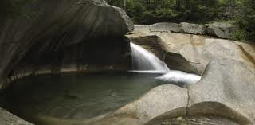
Basin
A low lying area surrounded by higher land that used to be filled with water.
http://www.google.com/imgres?q=basin&hl=en&biw=1440&bih=665&tbm=isch&tbnid=XW2LCOWOocyTJM:&imgrefurl=http://www.cannonmt.com/basin.html&docid=XwSyJfZX4Qf7cM&imgurl=http://www.cannonmt.com/image/basin_0114.jpg&w=500&h=246&ei=gShrUObvIYq6qgHz-ICABw&zoom=1&iact=hc&vpx=140&vpy=406&dur=796&hovh=157&hovw=320&tx=170&ty=142&sig=107800881789263530887&page=1&tbnh=80&tbnw=163&start=0&ndsp=21&ved=1t:429,r:14,s:0,i:193

Slide 3
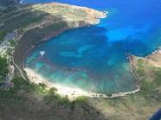
Bay
A part of a large body of water that extends into a shoreline.
They are smaller than a gulf.
http://www.google.com/imgres?q=bay&hl=en&biw=1440&bih=665&tbm=isch&tbnid=CDm2t_XS9ge8WM:&imgrefurl=http://en.wikipedia.org/wiki/Hanauma_Bay&docid=8MftzzHv5SfIwM&imgurl=http://upload.wikimedia.org/wikipedia/commons/thumb/e/ec/Hanauma_Bay.JPG/360px-Hanauma_Bay.JPG&w=360&h=270&ei=RChrULOgDcL_qwHmp4C4CQ&zoom=1

Slide 4
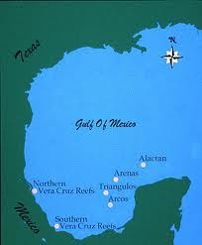
Gulf
Part of a large body of water that extends into a shoreline. Gulfs are very large and they indent very far into the land.
http://www.google.com/imgres?q=gulf&hl=en&biw=1440&bih=665&tbm=isch&tbnid=axIoWa7MOLHUNM:&imgrefurl=http://www.tpwd.state.tx.us/learning/webcasts/gulf/coral_reef.phtml&docid=ZPvSna-fGswCNM&imgurl=http://www.tpwd.state.tx.us/learning/webcasts/gulf/images/153_gulf_mex.jpg&w=300&h=362&ei=NidrUNWBK4nS2AXG4oAo&zoom=1&iact=rc&dur=156&sig=107800881789263530887&page=1&tbnh=138&tbnw=114&start=0&ndsp=21&ved=1t:429,r:4,s:0,i:148&tx=73&ty=106

Slide 5
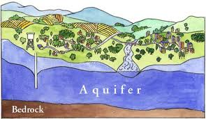
Aquifer
A layer of water-permeable rock beneath the land’s surface that contains a large store of water.
http://www.google.com/imgres?q=aquifer&hl=en&biw=1440&bih=665&tbm=isch&tbnid=hiTALHouRhR7MM:&imgrefurl=http://www.oldsaybrookct.org/Pages/OldSaybrookCT_APA/index&docid=7QXegiDVKUM7EM&imgurl=http://www.oldsaybrookct.org/Pages/OldSaybrookCT_APA/0310D3E6-000F8513.1/aquifer.jpg&w=500&h=290&ei=7ydrUP6PFcaBqgGHmIDoBA&zoom=1&iact=hc&vpx=164&vpy=341&dur=1045&hovh=171&hovw=295&tx=165&ty=105&sig=107800881789263530887&page=1&tbnh=108&tbnw=186&start=0&ndsp=18&ved=1t:429,r:6,s:0,i:155

Slide 6
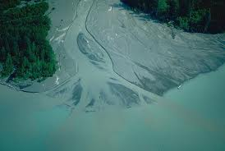
Delta
Land that is created at the mouth of a river by the deposition of sediments from the flow of that river. This land tends to be flat and marshy.
http://www.google.com/imgres?q=delta&hl=en&biw=1440&bih=665&tbm=isch&tbnid=OlnUshj8hF9zSM:&imgrefurl=http://www.alaska-in-pictures.com/kenai-river-delta-1958-pictures.htm&docid=Xmnm_aT8ngqDYM&imgurl=http://www.alaska-in-pictures.com/data/media/19/kenai-river-delta_1958.jpg&w=468&h=315&ei=aydrUMDvEIni2AWiiIHABQ&zoom=1&iact=hc&vpx=1035&vpy=379&dur=6880&hovh=184&hovw=274&tx=142&ty=151&sig=107800881789263530887&page=1&tbnh=136&tbnw=181&start=0&ndsp=21&ved=1t:429,r:19,s:0,i:195

Slide 7
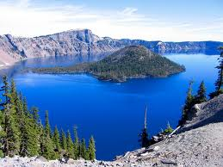
Lake
A large body of water surrounded by land, usually containing fresh water with little flowing current.
Crater Lake
(Oregon)
http://www.google.com/imgres?q=river&hl=en&biw=1440&bih=665&tbm=isch&tbnid=L0B8ZFCW77ftBM:&imgrefurl=http://en.wikipedia.org/wiki/River&docid=EvzIU8N-q9OzAM&imgurl=http://upload.wikimedia.org/wikipedia/commons/thumb/9/9e/The_River_Cam_from_the_Green_Dragon_Bridge.jpg/220px-The_River_Cam_from_the_Green_Dragon_Bridge.jpg&w=220&h=165&ei=GiZrUO34GMXs2AXkhICACg&zoom=1&iact=rc&dur=109&sig=107800881789263530887&page=1&tbnh=132&tbnw=176&start=0&ndsp=18&ved=1t:429,r:0,s:0,i:139&tx=141&ty=65

Slide 8
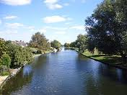
River
A large natural stream of water with a current that runs through the land
http://www.google.com/imgres?q=river&hl=en&biw=1440&bih=665&tbm=isch&tbnid=L0B8ZFCW77ftBM:&imgrefurl=http://en.wikipedia.org/wiki/River&docid=EvzIU8N-q9OzAM&imgurl=http://upload.wikimedia.org/wikipedia/commons/thumb/9/9e/The_River_Cam_from_the_Green_Dragon_Bridge.jpg/220px-The_River_Cam_from_the_Green_Dragon_Bridge.jpg&w=220&h=165&ei=GiZrUO34GMXs2AXkhICACg&zoom=1&iact=rc&dur=109&sig=107800881789263530887&page=1&tbnh=132&tbnw=176&start=0&ndsp=18&ved=1t:429,r:0,s:0,i:139&tx=141&ty=65

Slide 9
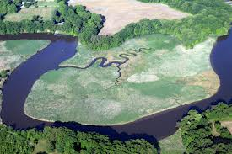
Tributary
A small river or stream that flows into a large river or stream; a branch of the river
http://www.google.com/imgres?q=tributary&hl=en&biw=1440&bih=665&tbm=isch&tbnid=znlJOMAU5SajcM:&imgrefurl=http://ian.umces.edu/imagelibrary/displayimage-1506.html&docid=e4Y5v1dt-7Tv4M&imgurl=http://ian.umces.edu/imagelibrary/albums/userpics/10040/normal_iil_ian_jt_0562.jpg&w=600&h=400&ei=sCJrULiOJojPrQHysIG4Bw&zoom=1&iact=hc&dur=16&sig=107800881789263530887&page=1&tbnh=135&tbnw=179&start=0&ndsp=24&ved=1t:429,r:12,s:0,i:147&tx=192&ty=92&vpx=696&vpy=330&hovh=183&hovw=275

Slide 10
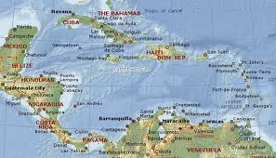
Sea
A large body of salt water completely or mostly surrounded by continental land or by continental land and archipelagos
http://www.google.com/imgres?q=caribbean+sea&hl=en&biw=1440&bih=665&tbm=isch&tbnid=Qkv62XSEjsVD0M:&imgrefurl=http://www.thelivingocean.net/2012/05/caribbean-sea-should-be-protected.html&docid=8zb8CtN77iUzYM&imgurl=http://1.bp.blogspot.com/-9KyDL9R1aUk/T6Ffv_V0ycI/AAAAAAAAFEY/QOOIugcN8FI/s1600/zzzzzzcaribbean_sea_map.jpg&w=672&h=384&ei=VeZqUM7bBo7bqwH0_4HQCQ&zoom=1&iact=rc&dur=592&sig=107800881789263530887&page=1&tbnh=106&tbnw=186&start=0&ndsp=18&ved=1t:429,r:2,s:0,i:116&tx=86&ty=79

Slide 11
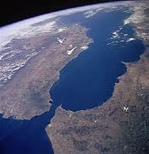
Strait
A narrow stretch of water joining 2 larger bodies of water.
The Alboran Sea
Spain
(Europe)
The Strait of Gibraltar
Morocco
(Africa)
The Atlantic Ocean
http://www.google.com/imgres?q=strait&hl=en&biw=1440&bih=665&tbm=isch&tbnid=diLD5xKXTHzqLM:&imgrefurl=http://en.wikipedia.org/wiki/Strait&docid=x3WvP3kbtEqkGM&imgurl=http://upload.wikimedia.org/wikipedia/commons/thumb/c/cf/Strait_of_gibraltar.jpg/220px-Strait_of_gibraltar.jpg&w=220&h=228&ei=3yNrUIK4Febm2AXR5YHQCA&zoom=1

