Slide 1
Physical Geography
Landforms

Slide 2
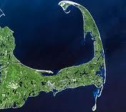
Cape
A piece of land jutting into the sea or some other large body of water. It is usually much smaller and stubbier than a peninsula.
Cape Cod
(Massachusetts)
http://www.google.com/imgres?q=cape&num=10&hl=en&biw=1024&bih=533&tbm=isch&tbnid=Hu-v_sSgv67LHM:&imgrefurl=http://en.wikipedia.org/wiki/Cape_Cod&docid=kE4_gx7ocdHB9M&imgurl=http://upload.wikimedia.org/wikipedia/commons/thumb/b/bc/Cape_Cod_Landsat_7.jpg/220px-Cape_Cod_Landsat_7.jpg&w=220&h=195&ei=RjZsULikMYeh2QW-qoGgCw&zoom=1&iact=rc&dur=62&sig=107800881789263530887&page=1&tbnh=131&tbnw=148&start=0&ndsp=10&ved=1t:429,r:1,s:0,i:142&tx=45&ty=58

Slide 3
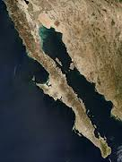
Peninsula
A large narrow strip of land projecting into a sea or lake from the mainland. The land forms an isthmus at the point where it connects from the mainland
Baja California
(Mexico)
http://www.google.com/imgres?q=baja+california&hl=en&biw=1024&bih=533&tbm=isch&tbnid=QdGb0M6mhx2SuM:&imgrefurl=http://en.wikipedia.org/wiki/Baja_California_peninsula&docid=UabRoaN8DyYtXM&imgurl=http://upload.wikimedia.org/wikipedia/commons/thumb/5/5f/Baja_peninsula_(mexico)_250m.jpg/237px-Baja_peninsula_(mexico)_250m.jpg&w=237&h=316&ei=FjdsUNCfMoHm2AX4wYD4Bw&zoom=1&iact=rc&dur=78&sig=107800881789263530887&page=1&tbnh=145&tbnw=124&start=0&ndsp=10&ved=1t:429,r:0,s:0,i:136&tx=77&ty=89

Slide 4
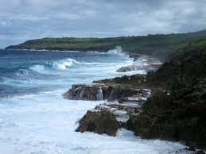
Coastline/Shoreline
The outline or contour of where a large body of water meets the land; defines the outer boundaries of continents, islands, capes, isthmuses, and peninsulas
http://www.google.com/imgres?q=coastline&hl=en&biw=1024&bih=533&tbm=isch&tbnid=rwWUrUhTx0u1sM:&imgrefurl=http://en.wikipedia.org/wiki/File:Niue_Coastline.jpg&docid=UqacQzKSAK_92M&imgurl=http://upload.wikimedia.org/wikipedia/commons/6/60/Niue_Coastline.jpg&w=1024&h=768&ei=3zdsUNPvB8Ls2gWc5oFo&zoom=1&iact=hc&vpx=390&vpy=189&dur=62&hovh=194&hovw=259&tx=120&ty=119&sig=107800881789263530887&page=1&tbnh=145&tbnw=174&start=0&ndsp=9&ved=1t:429,r:2,s:0,i:155

Slide 5
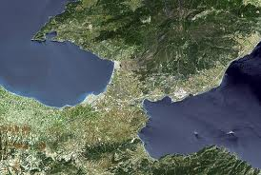
Isthmus
A narrow strip of land, bordered on both sides by water, connecting two larger bodies of land.
Corinth
(Greece)
land
water
water
http://www.google.com/imgres?q=isthmus&num=10&hl=en&biw=1440&bih=665&tbm=isch&tbnid=EOOQbBm8e0LjcM:&imgrefurl=http://www.jamiemiles.com/blog/musing-on-what-is-church-for/&docid=tDv7vPN8Y63eVM&imgurl=http://farm1.static.flickr.com/167/420400353_99fd962acc.jpg&w=500&h=335&ei=y1NsUOuYLeni2QW95YH4Aw&zoom=1&iact=hc&vpx=767&vpy=339&dur=3173&hovh=184&hovw=274&tx=98&ty=107&sig=107800881789263530887&page=1&tbnh=131&tbnw=186&start=0&ndsp=19&ved=1t:429,r:10,s:0,i:157
land

Slide 6
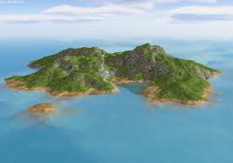
Island
A portion of land completely surrounded by water, and not large enough to be called a continent.
http://www.google.com/imgres?q=island&hl=en&biw=1440&bih=665&tbm=isch&tbnid=FqaRtf2zYN0bfM:&imgrefurl=http://stoneglasgow.blogspot.com/2011/04/island.html&docid=M3oR-Lxgdu_pDM&imgurl=http://2.bp.blogspot.com/-VroZTp4OxKE/TbZrUr0NjqI/AAAAAAAAAM8/jGv_L8HFs6Q/s1600/117332-stranded_island_following_5_actresses_item.jpg&w=1023&h=721&ei=RVVsUKDjA4Ge2AWWl4H4Cg&zoom=1&iact=rc&dur=94&sig=107800881789263530887&page=1&tbnh=141&tbnw=175&start=0&ndsp=19&ved=1t:429,r:0,s:0,i:149&tx=35&ty=40

Slide 7
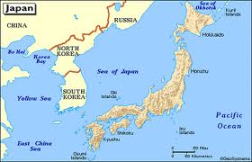
Archipelago
A cluster of islands or an island chain
Japan’s archipelago has 4 main islands but 6,852 total islands
http://www.google.com/imgres?q=is+japan+an+archipelago&um=1&hl=en&sa=N&biw=1440&bih=665&tbm=isch&tbnid=NRQWFvMXVbuErM:&imgrefurl=http://www.regentsprep.org/regents/global/themes/geography/bow.cfm&docid=cKP8CteLe-AhwM&imgurl=http://www.regentsprep.org/regents/global/themes/geography/images/japan.gif&w=435&h=279&ei=-FVsUIvUH4S82wWJjYGgDQ&zoom=1&iact=hc&vpx=1000&vpy=161&dur=889&hovh=180&hovw=280&tx=131&ty=136&sig=107800881789263530887&page=1&tbnh=128&tbnw=200&start=0&ndsp=21&ved=1t:429,r:5,s:0,i:88

Slide 8
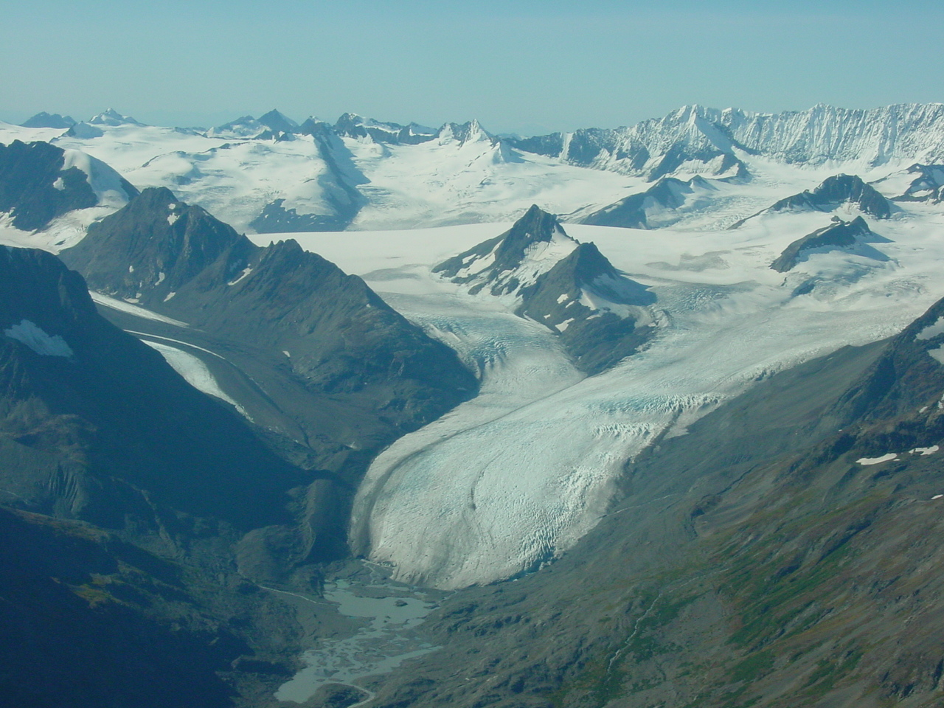
Glacier
A mass of ice formed from snow falling and accumulating over the years and moving very slowly
North/central Chugach Mountains, Alaska
http://www.google.com/imgres?q=glacier&um=1&hl=en&biw=1440&bih=665&tbm=isch&tbnid=xFnGLdYx1LcB8M:&imgrefurl=http://www.usgs.gov/features/glaciers2.html&docid=P9Y17SIay4fipM&imgurl=http://www.usgs.gov/images/topical/glaciers/dsc00035.jpg&w=1280&h=960&ei=WVpsUMWcN4bs2AWl6oHgBw&zoom=1&iact=hc&vpx=327&vpy=175&dur=6349&hovh=194&hovw=259&tx=192&ty=150&sig=107800881789263530887&page=2&tbnh=145&tbnw=203&start=20&ndsp=25&ved=1t:429,r:1,s:20,i:219

Slide 9
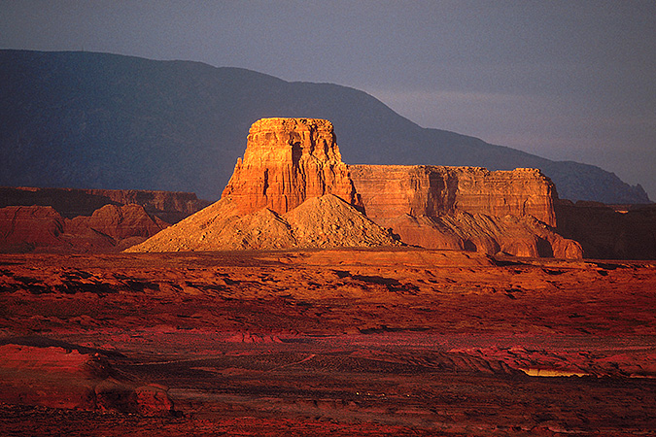
Mesa
A land formation that has steep sides and a relatively flat top. It is smaller than a plateau.
http://www.google.com/imgres?q=mesa&hl=en&biw=1440&bih=665&tbm=isch&tbnid=8PR3oTeunO8tFM:&imgrefurl=http://pinker.wjh.harvard.edu/photos/american_west/pages/mesa.htm&docid=dk7wPp781g3PgM&imgurl=http://pinker.wjh.harvard.edu/photos/american_west/images/mesa.jpg&w=675&h=450&ei=U15sUMbxHIeq2QW6moGQCA&zoom=1&iact=hc&vpx=962&vpy=334&dur=1997&hovh=183&hovw=275&tx=208&ty=85&sig=107800881789263530887&page=1&tbnh=135&tbnw=193&start=0&ndsp=19&ved=1t:429,r:10,s:0,i:167

Slide 10
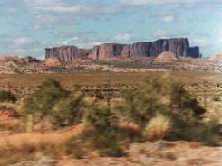
Plateau
A land area having a relatively level surface considerably raised above adjoining land

Slide 11
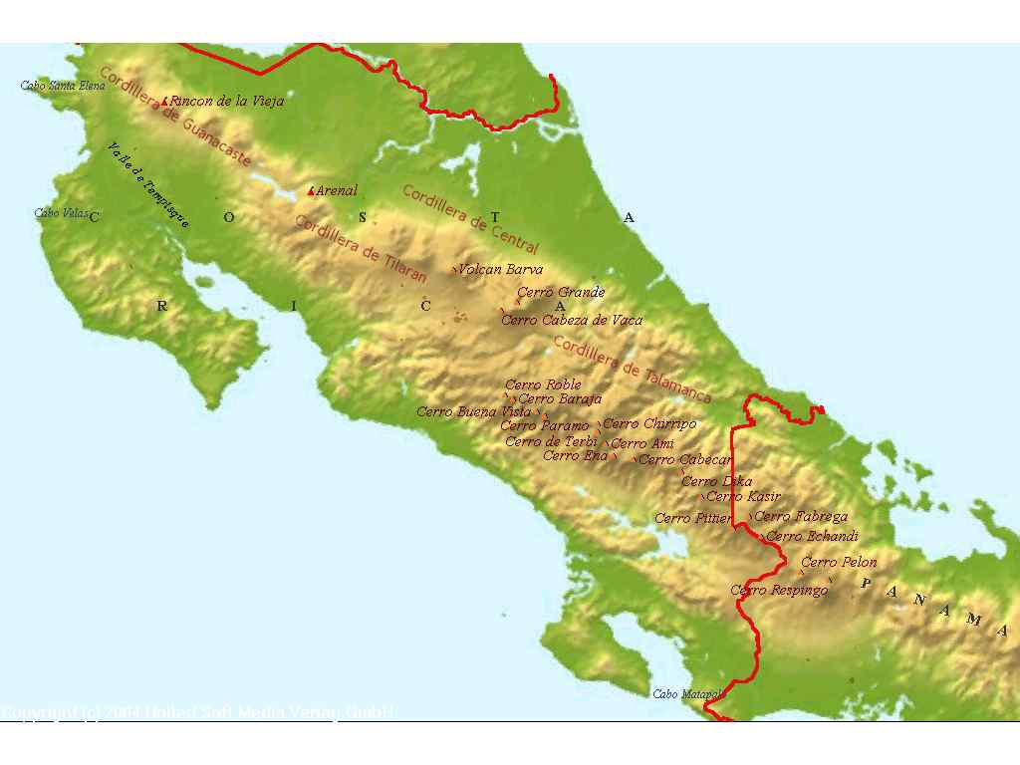
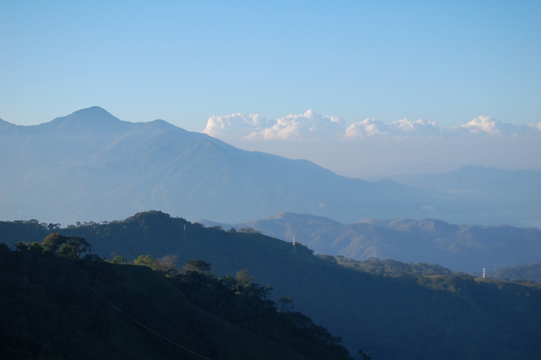
Mountain range
A series of mostly connected mountains arranged in a line
Costa Rican Mountain Ranges
http://www.google.com/imgres?q=mountain+range&start=91&um=1&hl=en&rlz=1R2AURU_enUS502&biw=1440&bih=665&addh=36&tbm=isch&tbnid=04a1amMpuLm8fM:&imgrefurl=http://www.fun-costa-rica-vacations.com/costa-rica-detailed-map.html&docid=g0MCEVnv5xY-qM&imgurl=http://www.fun-costa-rica-vacations.com/images/mountain-ranges-in-costa-rica.jpg&w=1024&h=768&ei=kl9sUIrpE4-_2QWYuoCgBA&zoom=1&iact=hc&vpx=973&vpy=283&dur=2278&hovh=194&hovw=259&tx=146&ty=104&sig=107800881789263530887&page=5&tbnh=140&tbnw=186&ndsp=24&ved=1t:429,r:10,s:91,i:37
http://www.flickr.com/photos/costa-rica-beauty/4751184585/

Slide 12
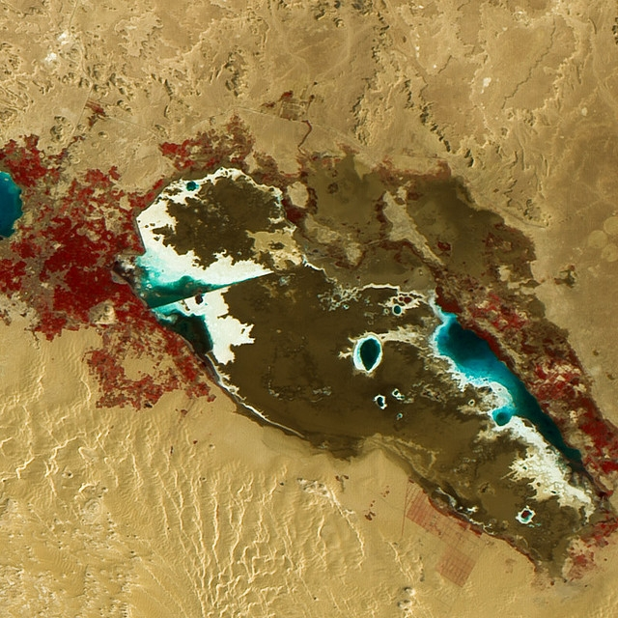
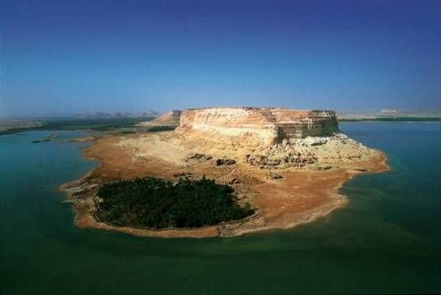
Oasis
A small fertile or green area in a desert region, usually having a spring or well.
http://artsytime.com/egypt/

Slide 13
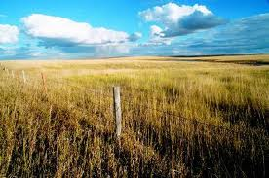
Plain
An area of land not significantly higher than adjacent areas and with relatively minor differences in elevation

Slide 14
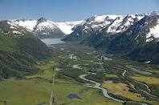
Valley
An extensive, more or less flat, and relatively low region drained by a great river system

Slide 15
Canyon
A canyon is a deep valley with very steep sides usually formed by water erosion from a river over millions of years.

Slide 16
Cliff
A cliff is a very steep face of rock and soil

Slide 17
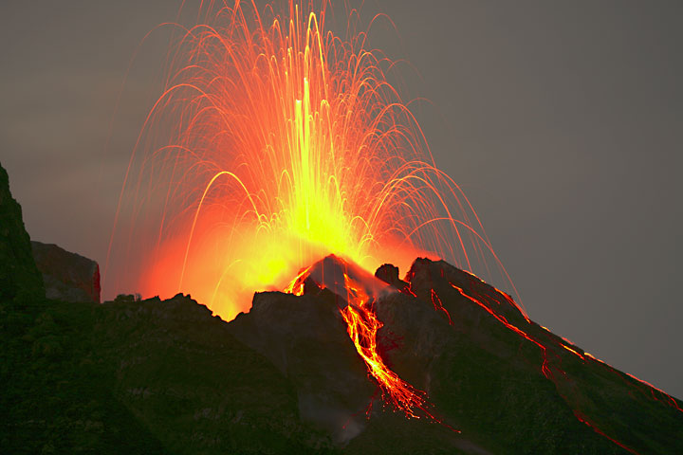
Volcano
A vent in the earth's crust through which lava, steam, ashes, etc., are expelled

Slide 18
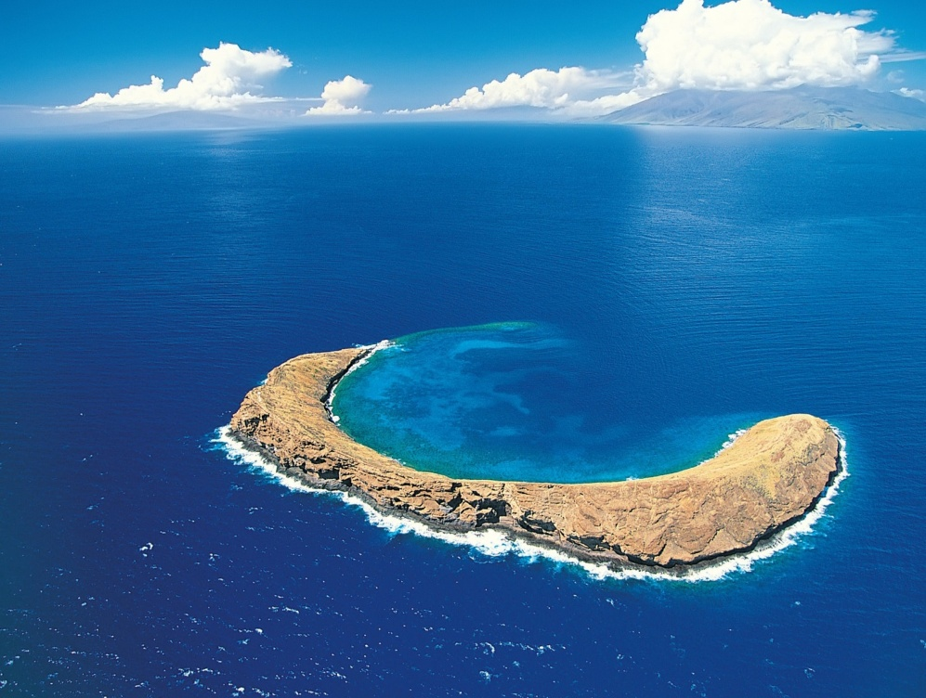
Atoll
An atoll is ring shaped (or partial ring shaped) island formed by coral. The coral forms around the top of a submerged volcano. There is always a volcano under an atoll.

